Slide 1
Program design

Slide 2
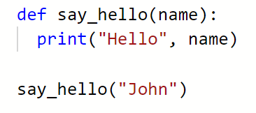

Last week – functions!!
Function name
Parameters
Function body

Slide 3
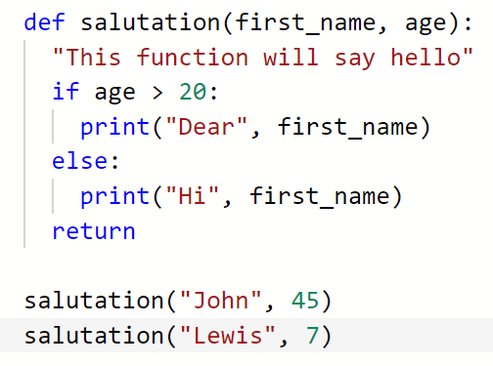
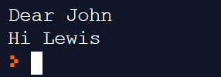
A block of code
It has a name
You can call the function
Input – parameters
Output – return value
Variables scoped to the block/function

Slide 4

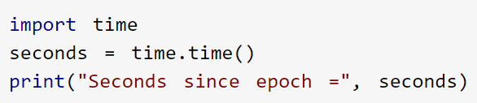
Functions – rules of thumb
Chunks of code
Reusable – fix bugs in one place. Keeps your programs shorter.
Makes the code easier to read
30 lines of code = a function
Use other peoples functions – Python import

Slide 5
So far…
So far we have looked at key programming concepts using Python
Programming skills building is an ongoing process:
Keep working through online tutorials
Take exercises that you have completed and “break” the code to see what happens.

Slide 6
Today - design
Investigate considerations to be taken when creating software products.

Slide 7
Program Design and Development
When designing and developing a software product, there are several factors a developer needs to consider:
Abstraction of data
Use of predefined code
Readability of code
Quality of code

Slide 8
Abstraction of Data
Abstraction is a representation (of something) that is arrived at by removing unnecessary details.
What on earth does that actually mean?!

Slide 9
Abstraction
The simplification of data
“Car” is an abstraction of a very complex piece of machinery with many thousands a of individual components.
Abstraction allows for the construction of data types.

Slide 10
Data Type Example
C (C++, C#, Java) based languages demonstrate this.
Look at the following diagram…

Slide 11
Abstraction
High level abstraction is a general outline
The purpose of the software product.
The lower the level of abstraction, the more detail we know.
Specific user requirements
Product parameters: what it should and should not do.

Slide 12
Abstraction – Questions?
Any questions about data abstraction?

Slide 13
Predefined Code
Predefined code is code which is available to a programmer through libraries.
E.g. using the import feature in Python
Common functions and procedures are predefined, such as:
String manipulation - .upper()
Printing to a console window – print()

Slide 14

Predefined Code
Saves the programmer from writing their own code for common tasks.
Makes code easier to read for teams of developers.
Code libraries allow code to be re-used in multiple programs.
Tested by millions of other programs – few bugs

Slide 15
Readability of Code
A good program will be coded so that it is as easy as possible for a human to read.
Why?

Slide 16
Readability of Code
A good program will be coded so that it is as easy as possible for a human to read.
Why?
Substantial software products will be made by teams of programmers.
Each (current and future) member of the team needs to be able to read the code.

Slide 17
To Ensure Readable Code Use:
Clear comments that state
What the code does
Why the code is doing something
Appropriate names for variables
E.g. inputNumber not n1
An agreed naming convention
firstName
first_name
Whitespace
Depending on the language use indentation and empty lines to make code neater – be careful with Python!

Slide 18
Quality of Code
Quality of code is concerned with efficient and well-structure code.
If program code lacks structure or is poorly written it will affect the performance of the program.
Slow running
Freezing/crashing

Slide 19
Code Should…
Be well structured
Logical are procedures called in a sensible order?
Have no redundancy
Make sure that code is not duplicated.
Make sure code does not include sections which are not needed.

Slide 20

Code Should…
Python Style Guide
2001
https://www.python.org/dev/peps/pep-0008/
Be consistent
Stick to an agreed naming convention
Code conventions – published and internal to a business
E.g. Camel Case
Follow an agreed format
Be robust
Stress tested
Does the program not only do what it should do, but does the code cope with extreme usage/data.
Stick to the rule of thumb of at least above 10% capacity.

Slide 21
Code Should…
Be modular
Modern programs should be modular, i.e. made up of modules(!).
These code modules can then be re-used in other programs independently.
Different teams can create each module independently.
Be maintainable
Once made can the code be easily updated?

Slide 22
Other Quality Considerations
Portability
Does the code need to be used across platforms?
Windows, Linux, Mac OS, etc.
Does the code need to be run on different processors/chipsets?
x86 processors, ARM processors, etc.

Slide 23
Worksheet
Worksheet in SharePoint
Finish coding worksheets from last week (functions)
Continue working through online course

